Slide 1

Process Mining Virtual Internship Virtual Internship
by
P.Sushma
Roll No. 214G1A32A7
Department of Computer Science and Engineering (Data Science)
Srinivasa Ramanujan Institute of Technology
(Affiliated to JNTUA & Approved by AICTE) (Accredited by NAAC with ‘A’ Grade & Accredited by NBA (EEE, ECE & CSE)
Rotarypuram Village, B K Samudram Mandal, Ananthapuramu – 515701.
2023 - 2024

Slide 2

Contents
Course Objective
Introduction
Technology
Applications
Modules
Real Time applications
Learning outcomes
GitHub Link
Queries

Slide 3
Course Objective
To gain proficiency in extracting insights from complex business processes, optimizing process efficiency, identifying bottlenecks, and proposing data-driven improvements.
You will have the skills to confidently apply Process Mining methodologies within various industries, to make informed decisions that drive excellence and process improvement.
Process mining applies data science to discover, validate and improve workflows. By combining data mining and process analytics, organizations can mine log data from their information systems to understand the performance of their processes, revealing bottlenecks and other areas of improvement.

Slide 4
Introduction
Prof. Dr. Mathias Weske said “A business process is a collection of related, structured activities or tasks that in a specific sequence produce a service or product.”
A process is a series of actions or steps repeated in a progression from a defined or recognized 'start' to a defined or recognized 'finish'. The purpose of a process is to establish and maintain a commonly understood flow that allows a task to be completed as efficiently and consistently as possible.
Process Mining works by extracting knowledge from event logs readily available in today’s information systems, in order to visualize business processes and their every variation as they run.
For sales, it could be the steps to progress an opportunity from a lead to closure.
Take order management, for example: This could be the steps from a customer ordering goods, to you shipping, and then ultimately getting paid for them.

Slide 5
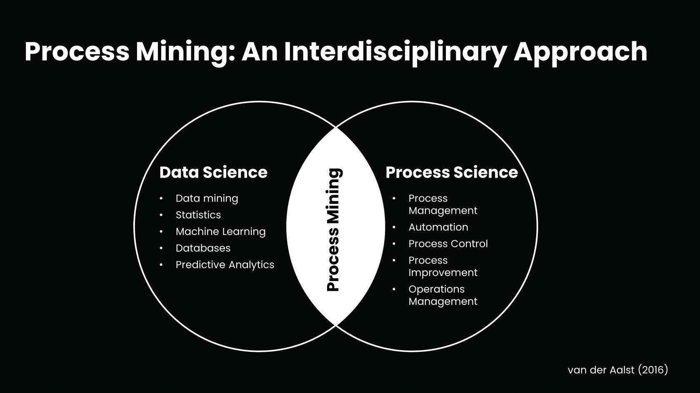
Continued..
Process Mining is the combination of two disciplines: Data Science and Business Process Management. Process Mining essentially uses Data Science techniques, such as Big Data and AI, to address Process Science problems such as process improvement and automation.

Slide 6
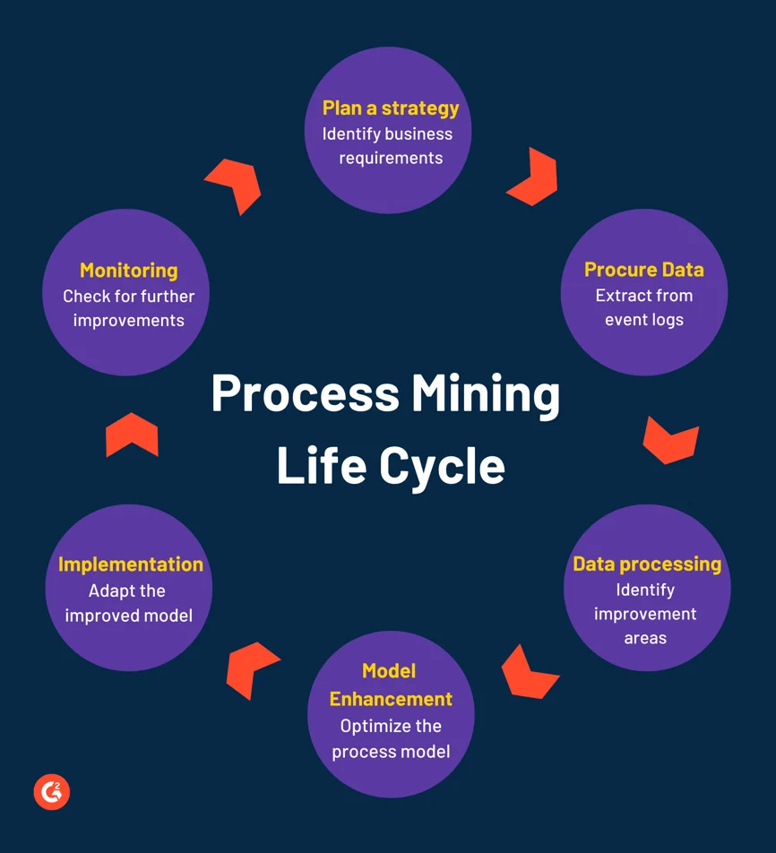
Continued..

Slide 7
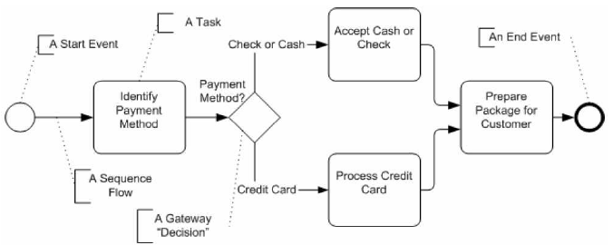
Continued..

Slide 8
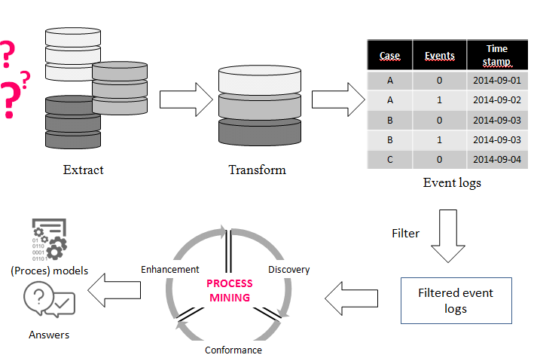
Continued..

Slide 9
Technology
Process Enhancement and Optimization: Insights gained from Process Mining Virtual Internship can be used to optimize processes. By identifying bottlenecks and inefficiencies, organizations can make informed decisions about how to improve their processes.
Predictive Analytics: Some advanced Process Mining Virtual Internship approaches incorporate predictive analytics to forecast future process behaviors based on historical data. This can aid in proactive decision-making and resource allocation.
Visual Analytics: Visualization tools play a crucial role in Process Mining Virtual Internship. They help in representing complex process data and insights in a visual and understandable manner, aiding in decision-making.
Machine Learning and AI Techniques: Machine learning algorithms can be applied to event log data for more advanced analyses, such as predicting process outcomes, anomaly detection, and clustering of process instances.

Slide 10
Continued..
Big Data Technologies: As organizations deal with large volumes of event log data, big data technologies like distributed processing and storage frameworks are used to handle and process the data efficiently.
Integration with Process Management Systems: Process Mining Virtual Internship tools often integrate with existing process management or business process management systems (BPMS) to facilitate seamless analysis and improvement of processes.
Event Log Data Collection: Event logs are at the core of Process Mining Virtual Internship. They capture events and activities performed within a process. These logs can be generated by various information systems such as ERP systems, CRM systems, and more.
Data Preprocessing: Before analysis, event log data often requires preprocessing. This involves tasks like data cleaning, data transformation, and dealing with missing values.
Performance Analysis: Performance analysis focuses on understanding the time aspects of a process like analyzing cycle times, bottlenecks, waiting times as areas to improve.

Slide 11
Applications
Business Process Improvement: Process Mining Virtual Internship is commonly used to identify bottlenecks, inefficiencies, and deviations from standard procedures in business processes. By analyzing event logs, organizations can uncover areas for optimization and implement changes to improve process efficiency and effectiveness.
Compliance and Auditing: In regulated industries, Process Mining Virtual Internship helps ensure that processes adhere to compliance standards and regulations. It allows organizations to detect deviations from prescribed procedures and demonstrate compliance during audits.
Customer Journey Analysis: Process Mining Virtual Internship can be applied to understand customer interactions and journeys across touchpoints in various industries, such as retail, e-commerce, and banking. This insight helps organizations enhance customer experiences and identify areas for improvement.

Slide 12
Continued..
Fraud Detection: Process Mining Virtual Internship is employed to detect fraudulent activities by analyzing patterns and anomalies in event logs by identifying unusual behavior to minimize fraud.
Logistics and Transportation: Process Mining Virtual Internship helps logistics companies optimize routes, track shipments, and improve overall transportation efficiency.
Financial Process Analysis: In the financial sector, Process Mining Virtual Internship can be applied to analyze loan approval processes, claims processing, and other financial operations to improve accuracy and speed.
Telecommunications Process Optimization: Telecom companies use Process Mining Virtual Internship to optimize customer service processes, network maintenance, and billing operations.

Slide 13
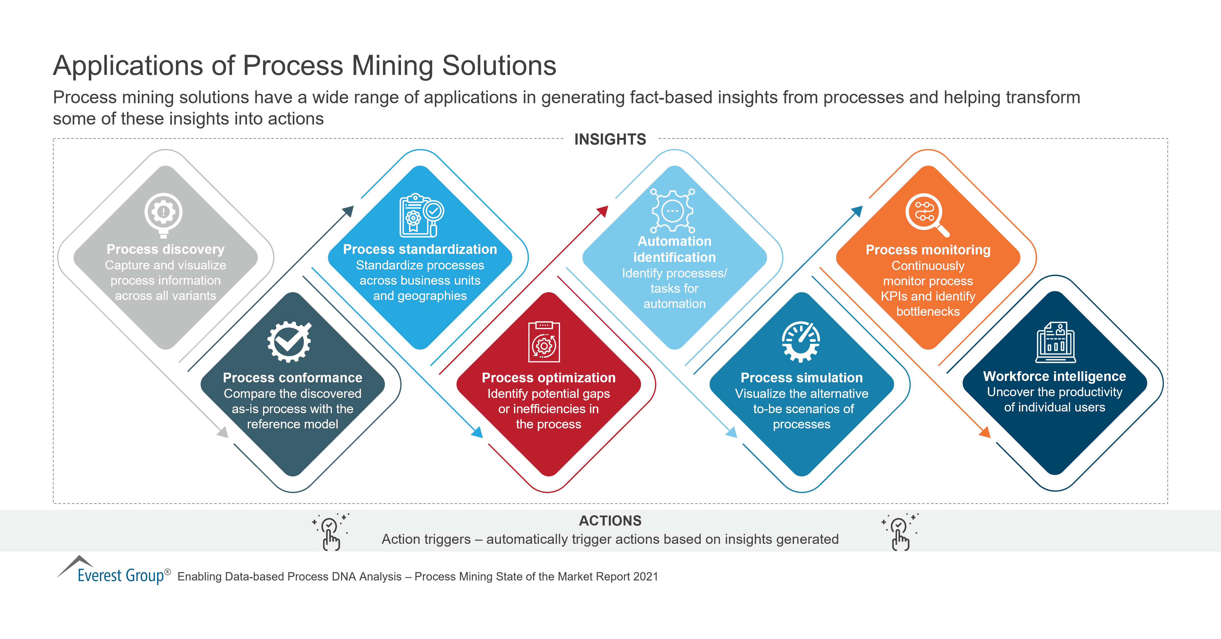
Continued..

Slide 14
Modules
Level - 1 : Introduction to Process Mining
Process mining is a dynamic approach that transforms raw event log data into valuable insights, driving operational efficiency and informed decision-making within organizations. By visualizing and analyzing these event logs, process mining uncovers the intricate pathways of business processes, exposing bottlenecks, variations, and inefficiencies. It goes beyond traditional process mapping, offering real-time, data-driven views that enable continuous improvement and optimization. Rooted in data analysis, process mining empowers businesses to enhance their processes iteratively, ensuring compliance, mitigating risks, and fostering collaboration across departments. Ultimately, process mining shapes a landscape of proactive problem-solving, accelerating digital transformation and cultivating a customer-centric approach to modern business challenges.

Slide 15
Continued..
Level - 2 : Learning Fundamentals of Process Mining
Process mining is a method that uses data to understand and improve business processes. It finds hidden patterns and problems in processes by analyzing event logs. This helps organizations make processes better, faster, and more efficient. It goes beyond simple maps by showing real-time visuals and suggesting ways to make things work smoother. Process mining also helps in following rules and working together across different parts of a business. It's like a guide for making processes work better and keeping up with changes in the world.
Level - 3 : To become a Rising Technical star
Writing PQL queries

Slide 16
Continued..
In process mining, you learn to write PQL queries, which are like special questions for understanding how a business process functions. These queries help you look closely at the steps, reasons, and ways to enhance the process. It's akin to using a detective's lens to zoom in and uncover the finer points within your processes, aiding in smarter decision-making and process refinement.
Getting Data into the EMS
In process mining, the focus shifts to getting data into the Event Collection System (EMS). This is like feeding the system with the details of what's happening in your processes. The EMS gathers event logs from various sources, creating a complete picture of how things are done. It's akin to collecting puzzle pieces that, when put together, show you the whole process. This step is crucial because without the right data, you can't analyze or improve your processes effectively.

Slide 17
Real Time Applications
Insurance Claims Processing: Insurance companies can use real-time process mining to expedite claims processing, ensuring accurate evaluations and timely payouts.
Retail Inventory Management: Real-time insights into sales and inventory data help retailers optimize stock levels, reducing overstocking or understocking issues.
Public Health Monitoring: Real-time process mining can assist health agencies in tracking disease outbreaks, analyzing patterns, and responding swiftly to public health emergencies.
Environmental Compliance Monitoring: Real-time insights help industries monitor emissions, waste disposal, and other environmental factors to ensure compliance with regulations.
Air Traffic Management: In aviation, real-time process mining aids air traffic controllers in managing flight paths, optimizing routes, and ensuring safe and efficient operations.

Slide 18
Learning Outcomes
Process Visualization: Learning to create clear and insightful visual representations of complex processes, helping stakeholders to comprehend process flows, variations, and performance.
Continuous Improvement: Gaining expertise in using process mining insights to iteratively improve and optimize processes, leading to enhanced efficiency, reduced costs, and improved outcomes.
Root Cause Analysis: Acquiring the capability to identify root causes of process inefficiencies and variations, facilitating targeted process improvements for sustainable results.
Data Analysis Proficiency: Developing strong data analysis skills to extract meaningful insights from event logs, including the ability to create queries, visualize data, and identify patterns.

Slide 19
Continued..
Process Understanding: Acquiring a deep understanding of how business processes actually work by analyzing event log data, which helps in identifying deviations, bottlenecks, and inefficiencies.
Compliance and Risk Management: Understanding how to use process mining to ensure compliance with regulations, identify risks, and mitigate potential issues proactively.
Decision Support: Developing skills to make informed decisions based on real-time process insights, enabling better resource allocation and strategic planning.
Problem-Solving and Innovation: Cultivating problem-solving skills by addressing process challenges with data-driven solutions, fostering a culture of continuous innovation.

Slide 20
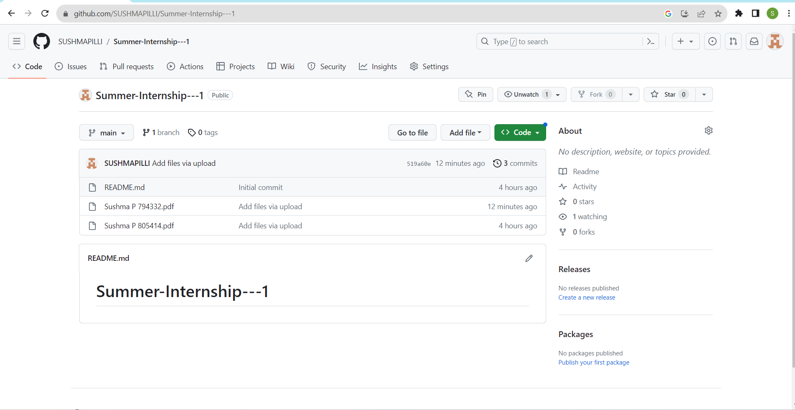

Git Hub Dashboard
Repository Name Like: Summer Internship - I
Under that include document, presentation and Certificate(Pdf).

Slide 21
Any Queries?

Slide 22
Thank You!!!

